Slide 1
Malignant comments Classification
Fliprobo.com

Slide 2
Problem statement and solution
Problem
The proliferation of social media enables people to express their opinions widely online. However, at the same time, this has resulted in the emergence of conflict and hate, making online environments uninviting for users. Although researchers have found that hate is a problem across multiple platforms, there is a lack of models for online hate detection.
Online hate, described as abusive language, aggression, cyberbullying, hatefulness and many others has been identified as a major threat on online social media platforms. Social media platforms are the most prominent grounds for such toxic behaviour.
There has been a remarkable increase in the cases of cyberbullying and trolls on various social media platforms. Many celebrities and influences are facing backlashes from people and have to come across hateful and offensive comments. This can take a toll on anyone and affect them mentally leading to depression, mental illness, self-hatred and suicidal thoughts.
Solution
Our goal is to build a prototype of online hate and abuse comment classifier which can used to classify hate and offensive comments so that it can be controlled and restricted from spreading hatred and cyberbullying.
From this model we can be predict whether the comment is 'malignant','highly_malignant','rude','threat','abuse','loathe'.

Slide 3
Choosing the evaluation metrics
This is a classification problem and I have choosen
1.Accuracy
2.Log-loss
3.Hammingloss as my evaluation metric

Slide 4
Data Preprocessing contd…
# 1. Import necessary libraries
# 2.Read the train.csv and test.csv file(parallely preprocessing is done for both train and test datasets).
# 3.Shuffling of indices, to avoid using train_test_split later
df = df.reindex(np.random.permutation(df.index))
# 4. Separate the comment feature(X) data and outcome labels(y)
#label = df[['malignant','highly_malignant','rude','threat','abuse','loathe']]
# Visualizations
# Data Preprocessing
### Removing excessive length for training data only.(kept as 400 keeping the computation power in consideration.)

Slide 5
Data Preprocessing contd…
# 5. Initializing the Vocabulary size(5000)
# 6. Making of corpus by GENERIC NLP FILTER CODE
a. Convert all cases to lower
b. Remove punctuations
c. Remove Stopwords
d. Stemming and Lemmatising
# 7.Applying embedding technique.(Count Vectoriser is giving memory error)
# 8. OneHot Encoding(or dummies)
# Initializing maximumu length of embedding_vector_features=30.
# 9. Applying embedding technique.(Count Vectoriser is giving memory error)
embedded docs--numerical(vector) format can be input to any ML or DL model)

Slide 6
Data Preprocessing contd…
# 10. Train_test_split training data(embedded_docs)in a different way as our target feature('labels') contains 6 classes.
#Our data is now ready for model building process input numerical format.
# Define all the 3 evaluation metrics(accuracy,logloss,hammingloss)
# PART-1-DL-NN-Model Building(score=87.97%) after GridsearchCV(88.007%)
.X(embedded_docs) y( df['label] )
. Model training(20 epochs)
. Predicting
. Check the accuracy. (accuracy=87.96% )
# GridsearchCV.(accuracy=88.26% )
Log-loss of 0.375 % only.

Slide 7
Data Preprocessing contd….
# PART-2--Multiple classifier ML models(4types)
# X(embedded_docs) y( df['label] )
# A. BinaryRelevance
from sklearn.naive_bayes import MultinomialNB
from sklearn.svm import SVC
from sklearn.naive_bayes import GaussianNB
# B.ClassifierChain
from skmultilearn.problem_transform import ClassifierChain
# C. LabelPowerset
from skmultilearn.problem_transform import LabelPowerset

Slide 8
Data Preprocessing contd….
# D.MLKNN
from skmultilearn.adapt import MLkNN
#In all the Models above
11. Predicting
12. Check the accuracy,log-loss,hamming score.
# Visualzitaion of Log-Loss and hamming loss of all models.
# Comparing All models and Concluding!
On basis of **hamming loss:-------------------
The best model would be **SVM classifier**. It has lowest hamming-loss of 4.384 % only.
On basis of **Log-Loss:--------------------
The best model will be the *Neural Network Model*. It has lowest Log-loss of 0.375% only.

Slide 9
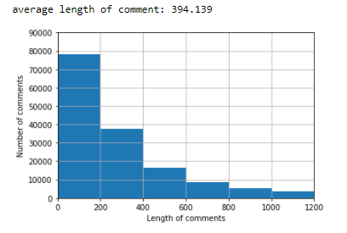
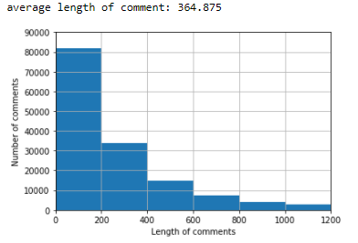
Visualization
Analyzing No. of comments having lengths varying from 0 to 1200
For train data
For test data

Slide 10
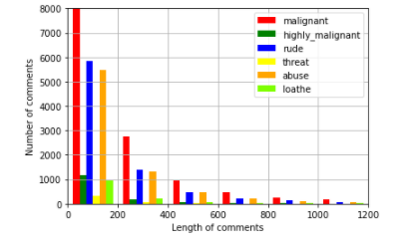
Visualization
Number of comments classified as malignant,highly_malignant,rude,....etc depending on their lengths for train data.
Inference from Data-→Data with low sentence lengths( <200) are malignant,highly_malignant & rude.

Slide 11
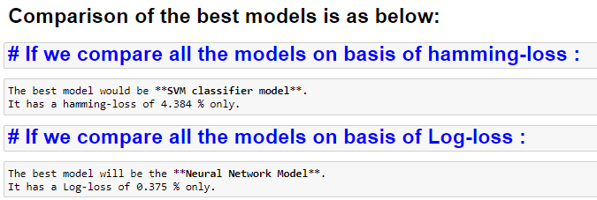
Choosing the final model

Slide 12
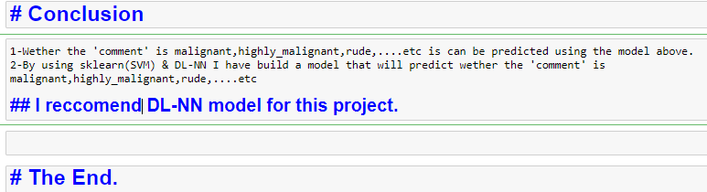
conclusion
Thank You

